Slide 1
Code Reviews & Self-documenting Code
because code is more often read than written

Slide 2
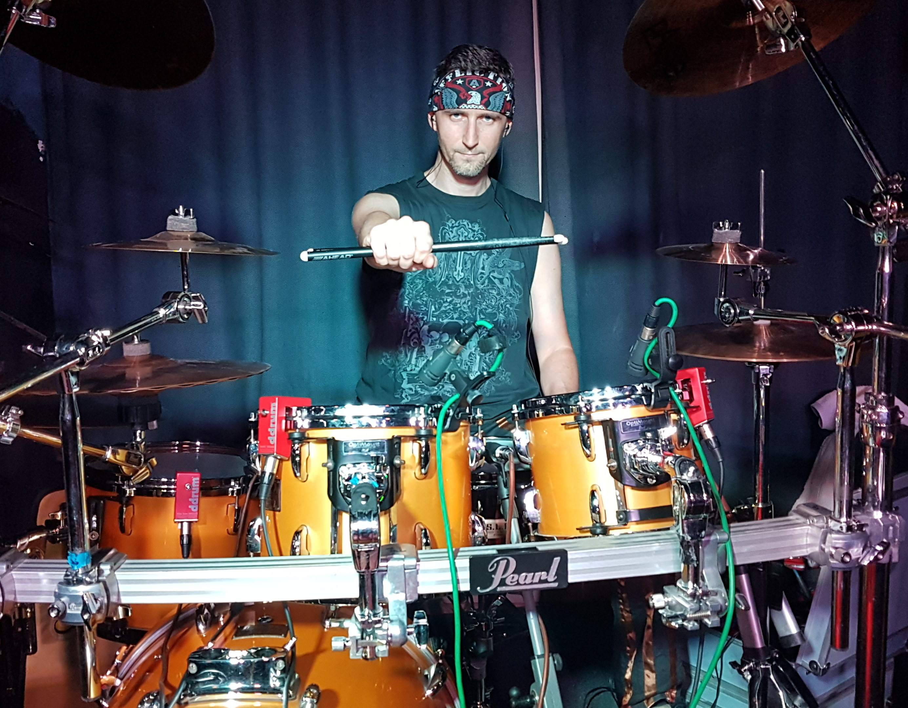
Viktor Gieci
Senior React Developer / Team Lead @CN Group CZ
Web tech enthusiast
Mentor
Sci-fi & fantasy fan
Dark chocolate lover
Mad rock drummer

Slide 3
Code Reviews
What are they ?
Why are they beneficial?
How we can approach them?
Dos & Don'ts
Where's the code???

Slide 4
What are Code Reviews anyway?
Methodical assessments of code designed to identify bugs, increase code quality, and help developers learn the source code
Important part of software development workflow
A programmer can only merge their changes back to the Matrix after having those changes reviewed and approved by other team members

Slide 5
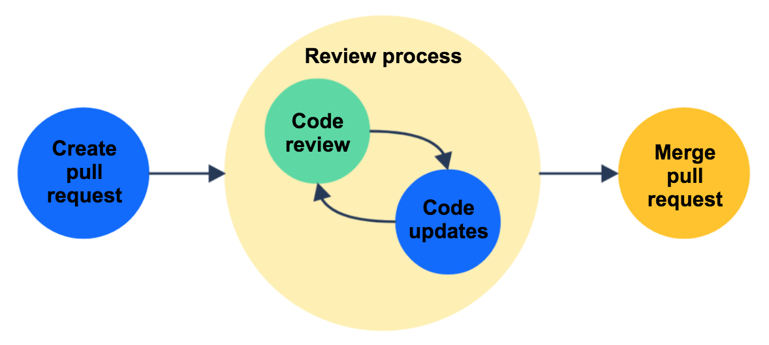
What are Code Reviews anyway?

Slide 6
Why are they beneficial?
Teaching and sharing knowledge
Coding standards compliance
Finding bugs early
Consistent design and implementation
Team cohesion
Help to maintain consistent coding style
When they are cheap to fix
Team members gain better understanding of the code base and learn from each other
Peer review helps to maintain a level of consistency in software design and implementation
Review discussions save team members from isolation and bring them closer to each other
Essential for junior mentoring

Slide 7
How to (technically) approach them?
Require creation and approval of pull requests before merging changes
Automate parts of the process with hooks and CI
Setup a pull request template with checklist
Encourage participation of all team members
Encourage leaving the code in a better shape than found

Slide 8
Dos & Don'ts
Avoid big PRs, split them into multiple steps if possible
Refactoring should be done in standalone PRs
Describe your PR (controversial?)
Avoid delays in Code Reviewing
Spending regular time on Code Review is hard, appreciate the effort

Slide 9
Dos & Don'ts (while commenting)
Be nice!
Don't blame or dictate, rather suggest or ask for clarification
Don't comment on unchanged code
Avoid jokes and sarcasm
Find compromises if need

Slide 10
Code Example

Slide 11
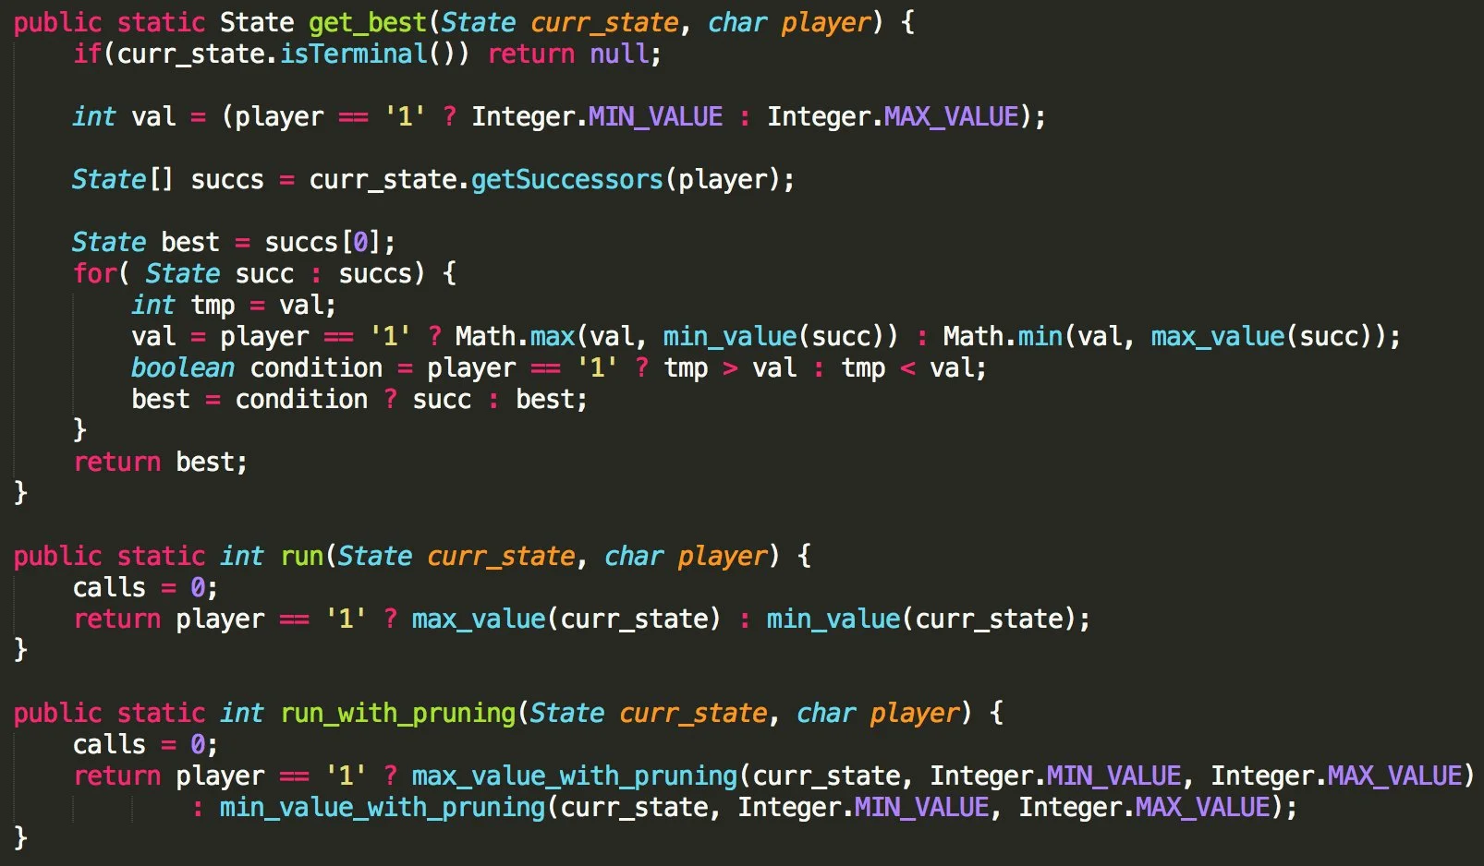

Slide 12
Don't forget
Code is more often read than written

Slide 13
THANK YOU 👨‍💻

Slide 14
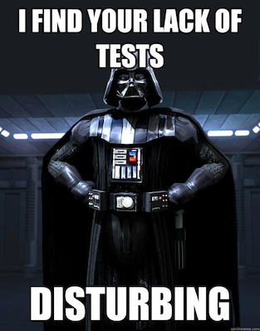
BONUS:Code Reviews are fun :)

